Slide 1
Interview Presentation
Mistake to Mystique:
Morphing Monolith to Services
David Helfrick
Mission Software Technical Director
November 4, 2022

Slide 2
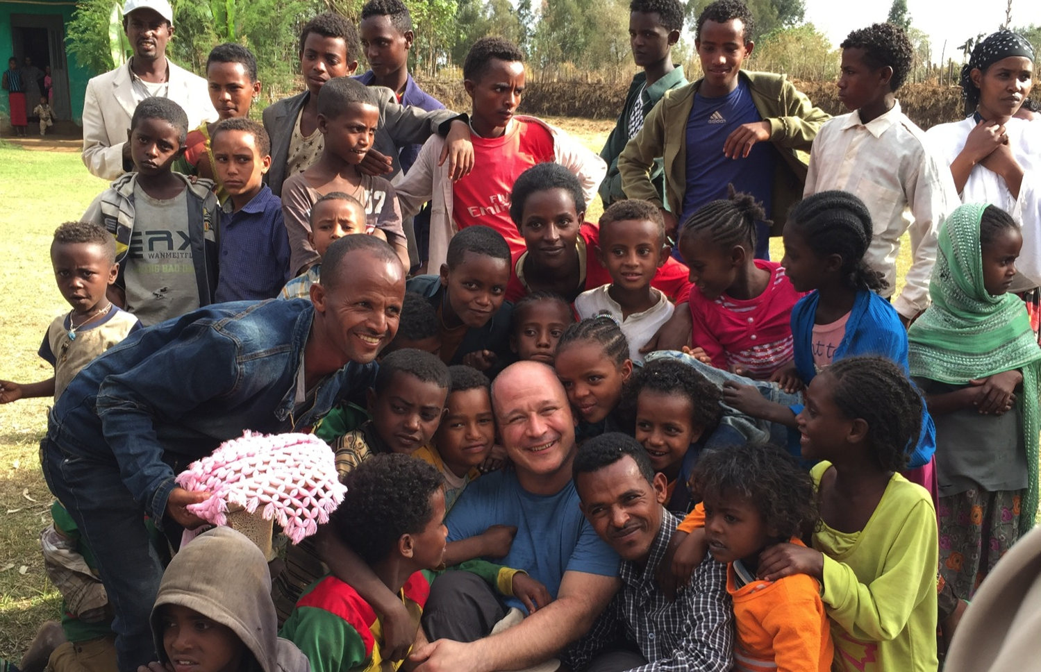
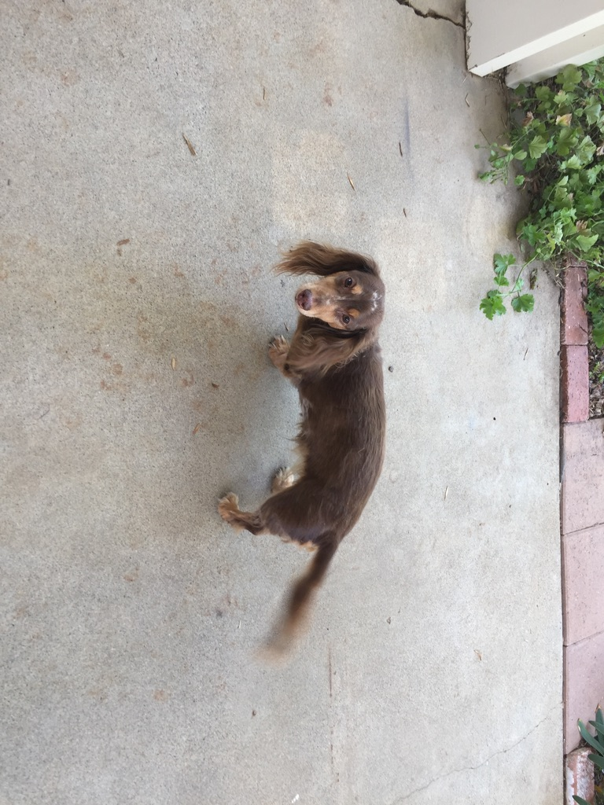
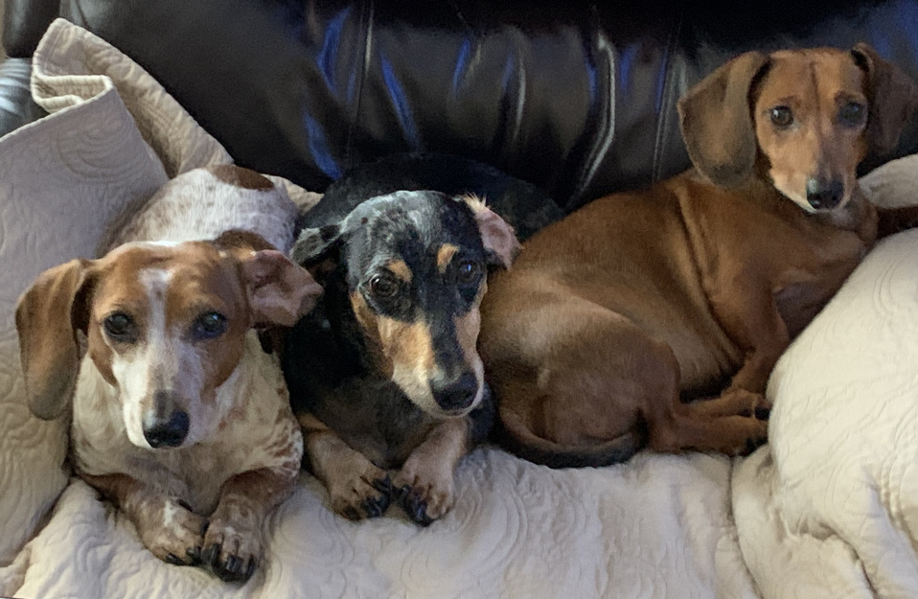
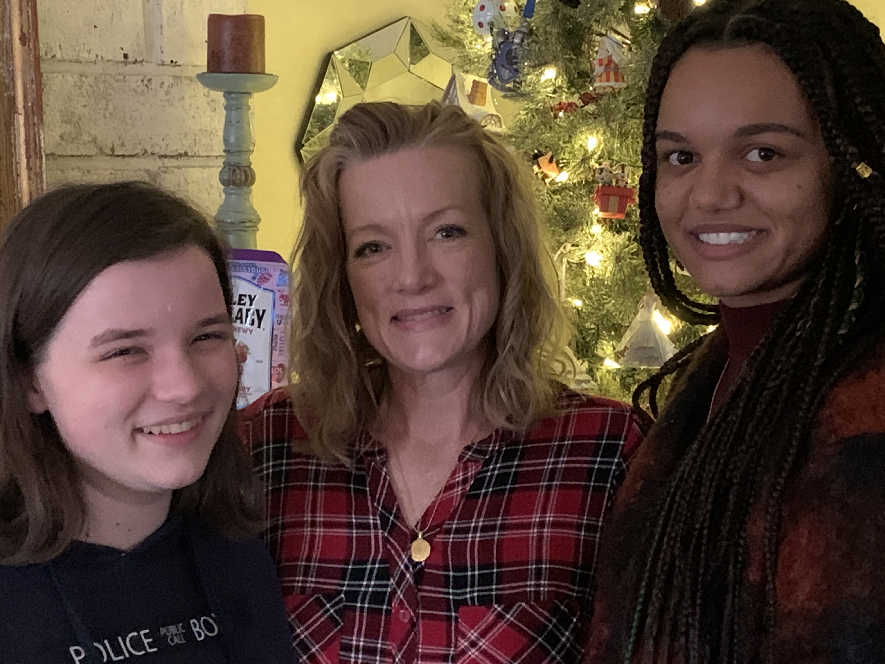

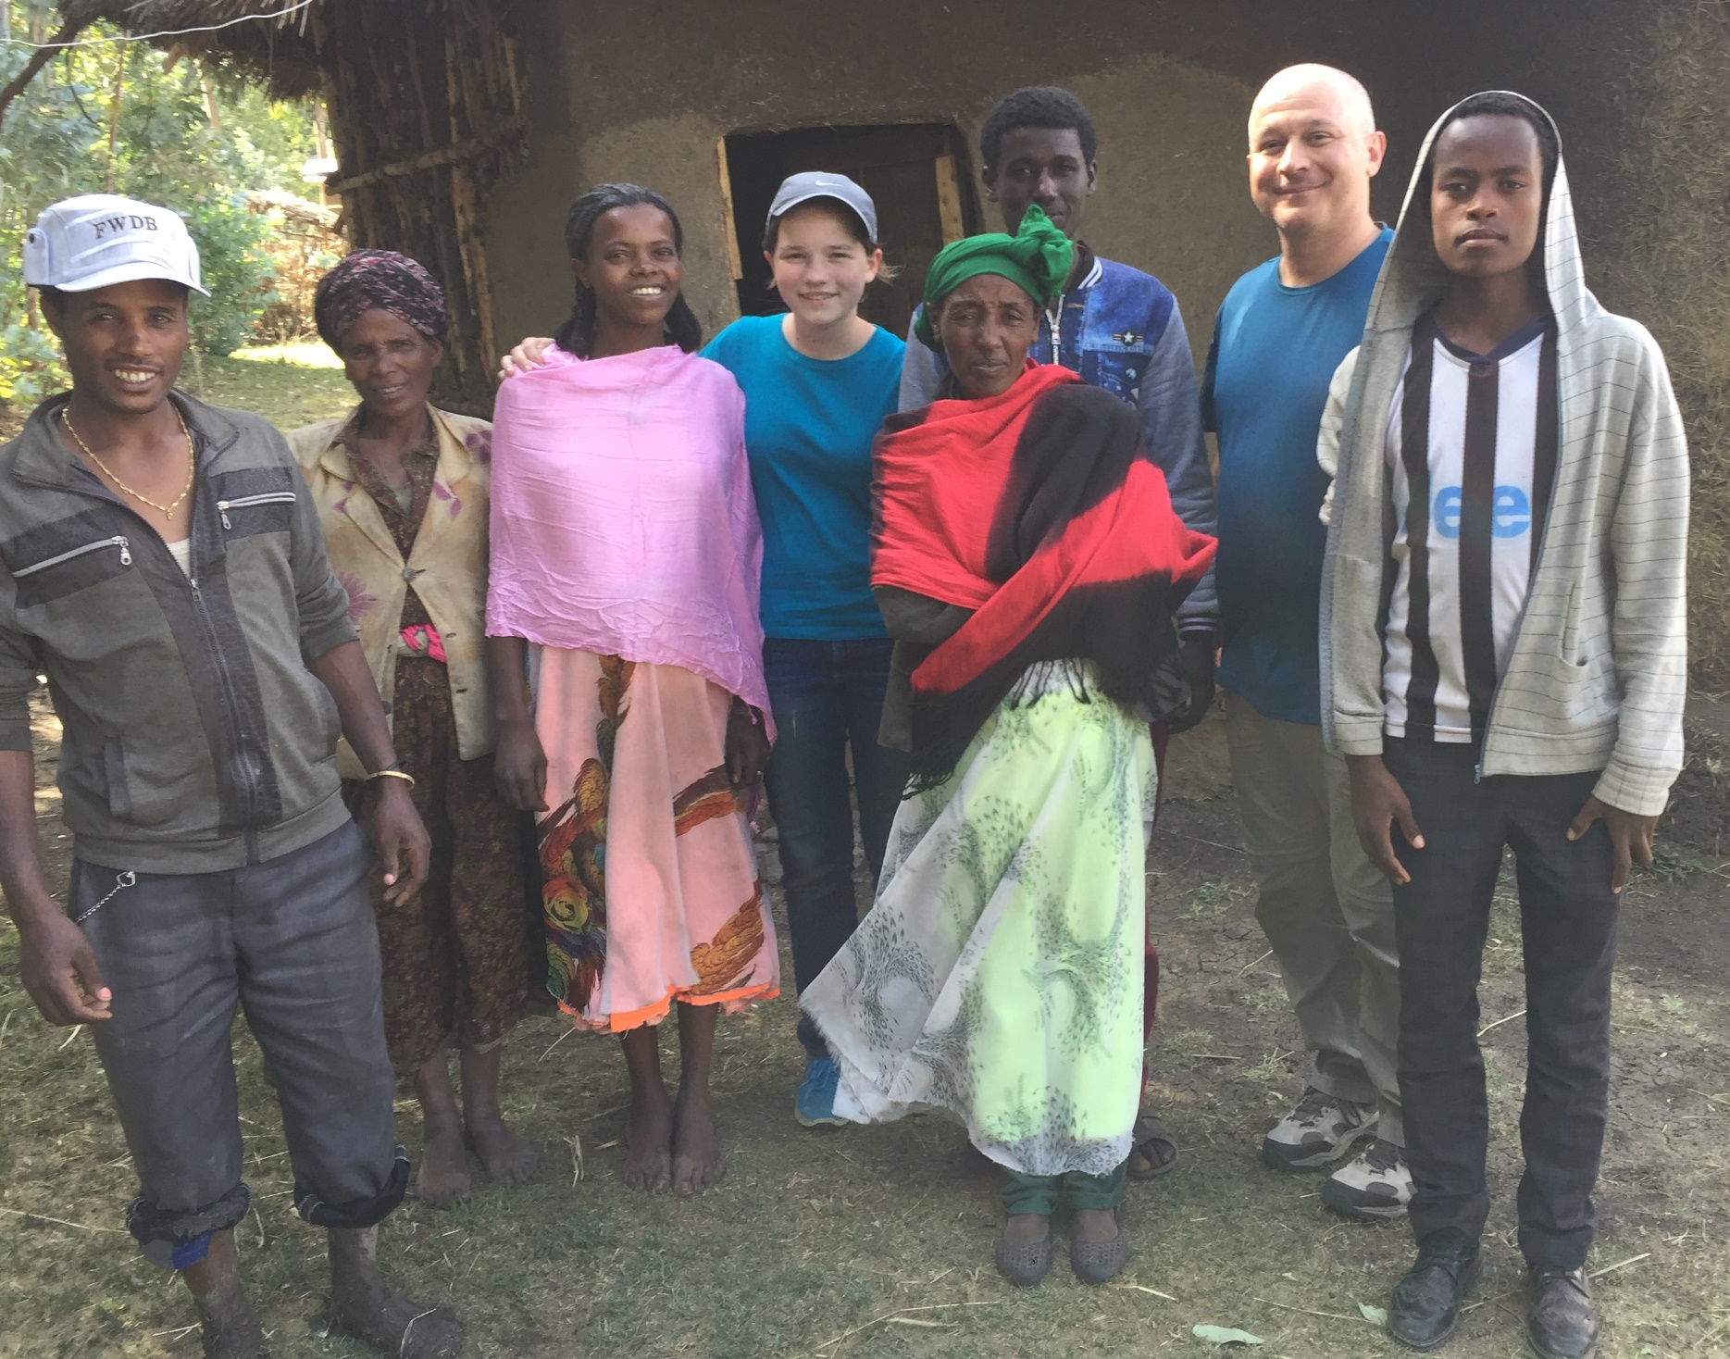
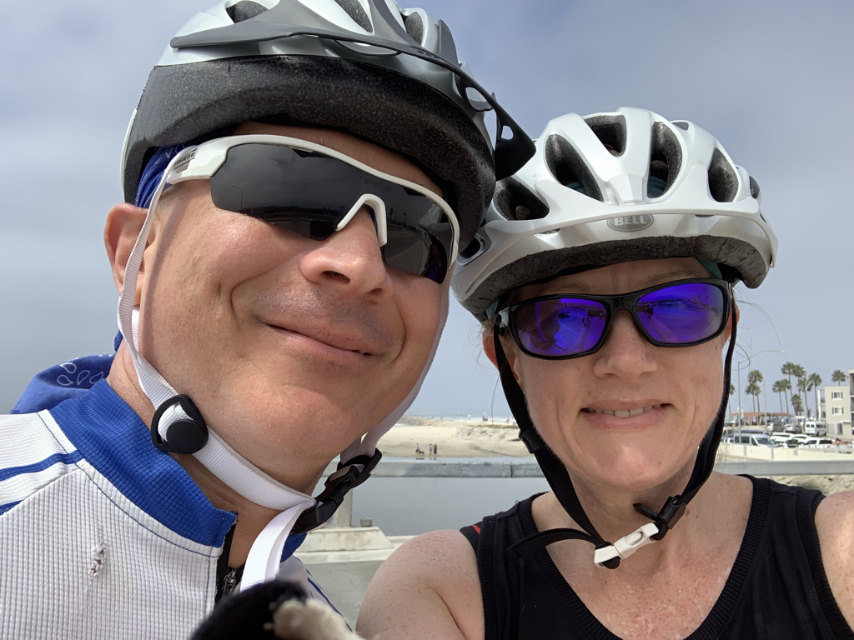
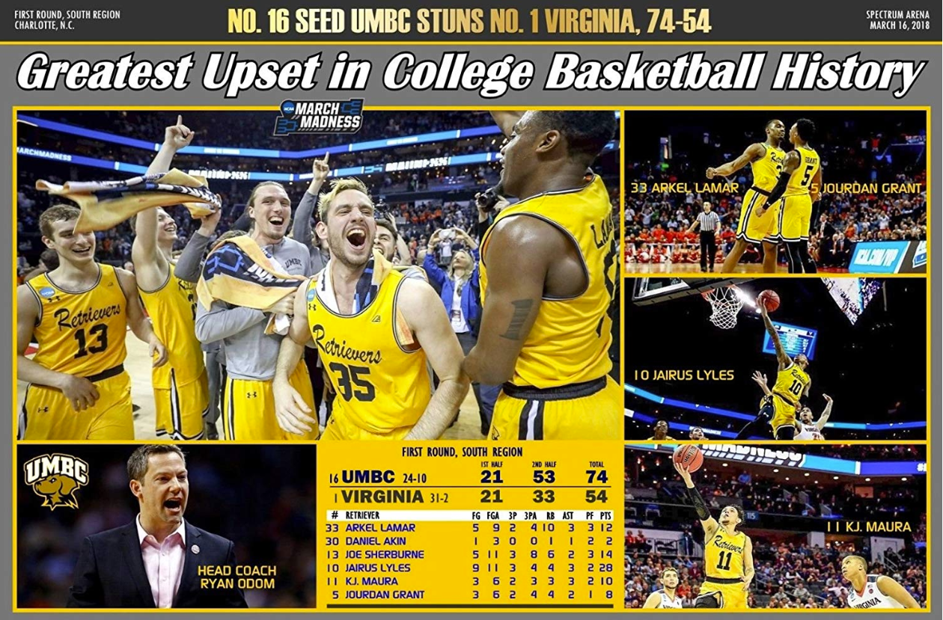

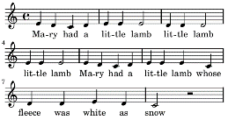
About David Helfrick
Wife (Suzanne)
Children
(Rachel, 20; Elizabeth 27)
Music

Slide 3
Outline
Why do something different?
What’s wrong with a monolith?
What are microservices?
Are (micro)services perfect?
Mystique
Questions
Notes:
Speaking from (new) Mission Software perspective, formerly Mission Systems Software

Slide 4
Why Do Something Different?
(The) testing (fallacy)
Side effects
(Lack of) separation
Reliability/availability
Deployment

Slide 5

(The) Testing (Fallacy)
I DON’T ALWAYS TEST MY CODE
BUT WHEN I DO, I DO IT IN PRODUCTION
Notes:
There is never enough time to run the manual tests
Manual testing also rarely stresses the system
Testing regularly gets squeezed in favor of completing development

Slide 6
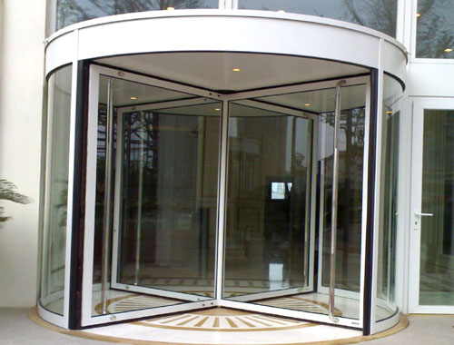
(Lack of) Separation
Separation and easy access?
Notes:
In software we want component separation for cleanliness.
We sometimes start with castles and a moat.
For schedules we want easy access and convenience.

Slide 7
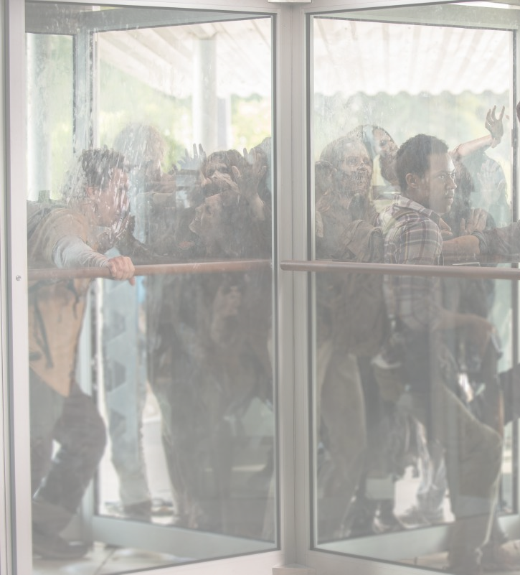
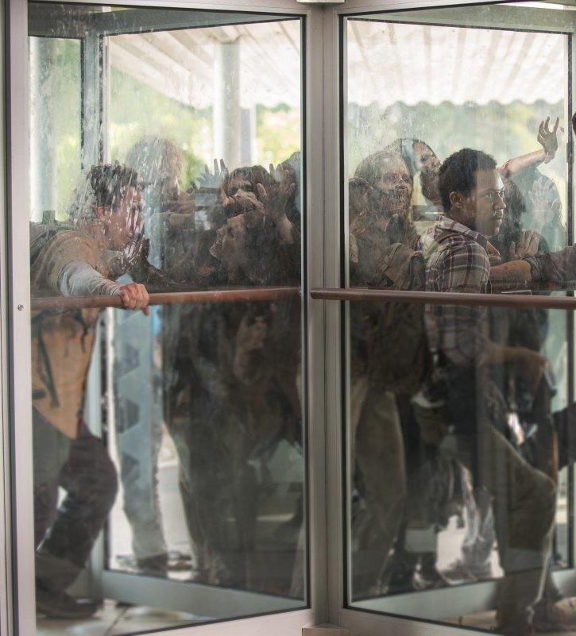
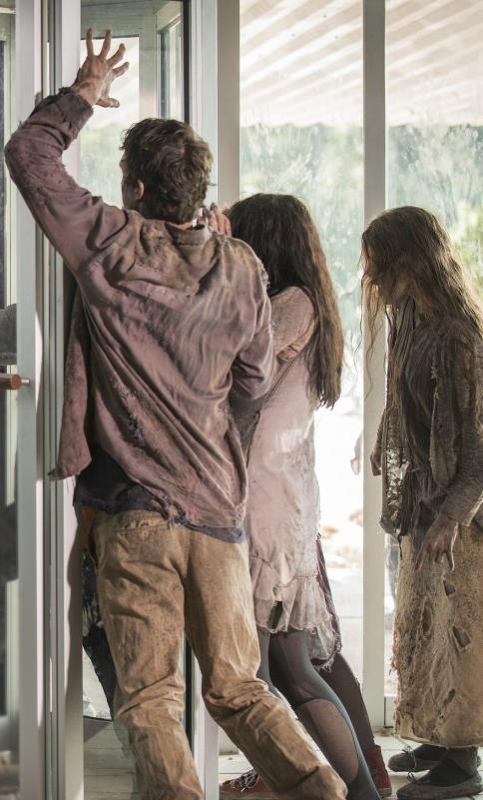
Comes Back to Bite Us
Thanks, Walking Dead.
Now these are horrifying!
Notes:
Over time, we end up with neither.

Slide 8
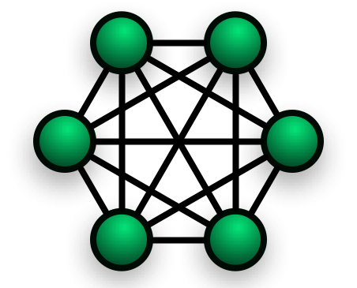
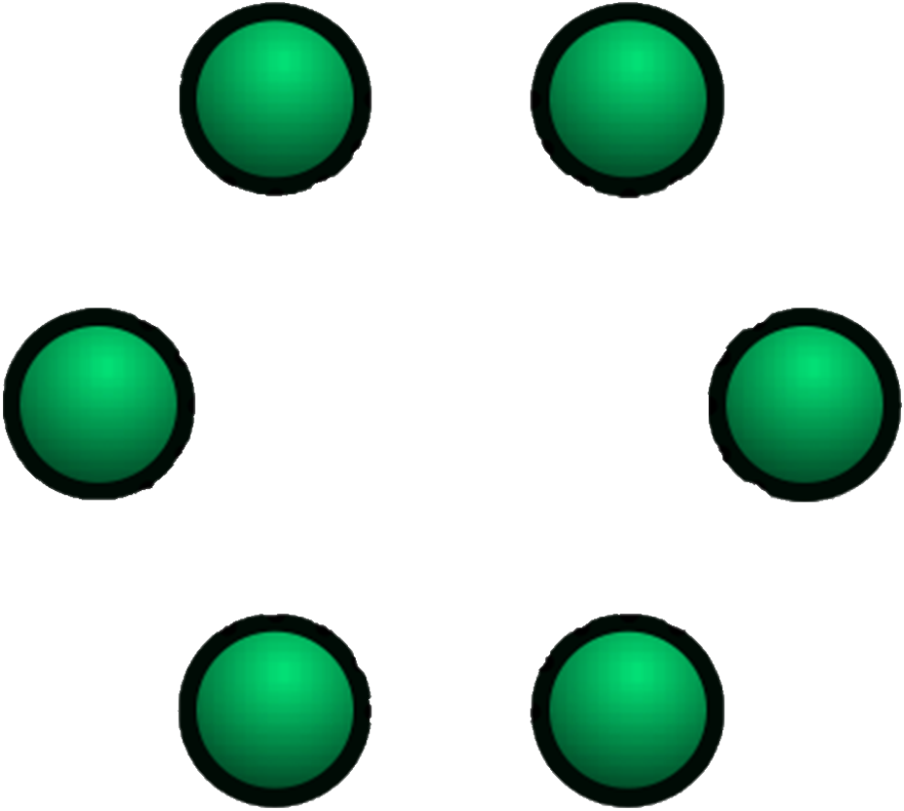
Reliability / Availability
(Modules without Separation)
Reliability / Availability
(Modules with Separation)
Dependencies between modules
Notes:
Looking at this another way…
We desire many components that are self contained, not dependent on other components.
Helfrick’s Law states that, over time, components become more and more messy.
As each component becomes dependent or “aware” of other components, we lose both the ability to modify or even release a single component in a vacuum.

Slide 9
Agility / Deployment
Impossible
Extremely Difficult
Notes:
Theoretical example to demonstrate the point that breaking a piece from a monolith is very challenging

Slide 10
Microservices – Deployment
Notes:
Theoretical chart to illustrate a point
Focus on right (we’ll return to left side)
Over time, the cost to release updates is much lower

Slide 11
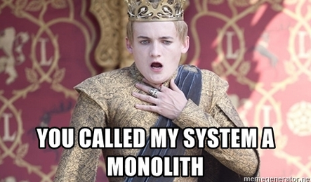
What’s Wrong With a Monolith?
Notes:
It’s trendy to disparage monolith software as well as our “old” software, but things happened for a reason.
A monolith is not always bad

Slide 12
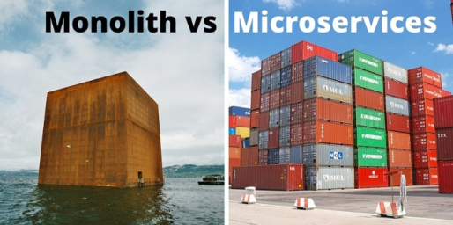
Monolith or Service?
.
Notes:
Monolith (simple, lightweight application)
Easier to implement
Quicker to first working version
One version for testing
Single shared database
Less infrastructure to manage
Direct component calls vs. messaging
Microservices (complex, evolving application)
Dependency Isolation
Enforced Boundaries
Overall Reliability
Targeted Changes

Slide 13
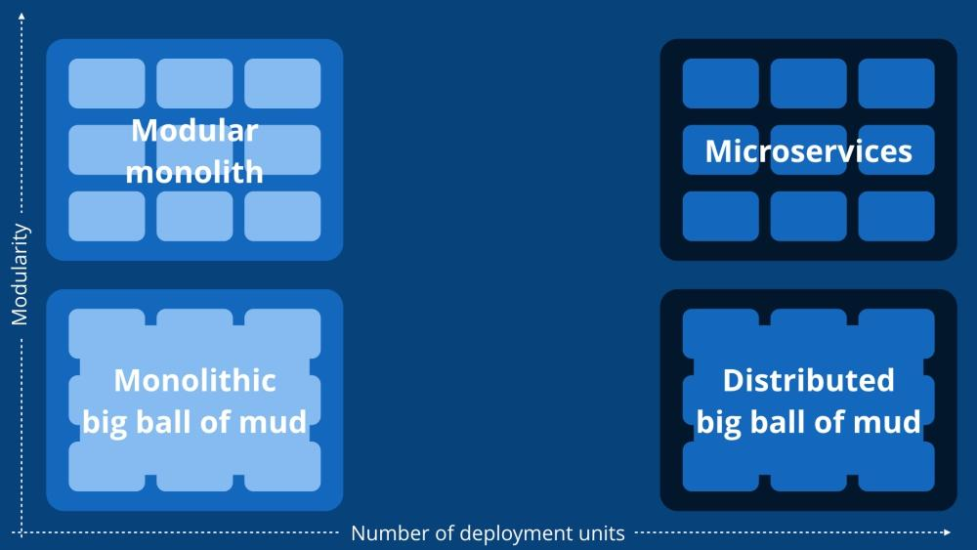
Monolith or Service?
Worst possible scenario
Best overall scenario
We are here
Too chaotic to get here
Notes:
A monolith was a good idea
(Click to get arrow.)
A modular monolith could be fabulous, but we lack the will here to implement it
(Click to get arrow.)
Distributed ball of mud would be a complete failure
(Click to get arrow.)
Microservices are compromise
(Click to get arrow.)

Slide 14
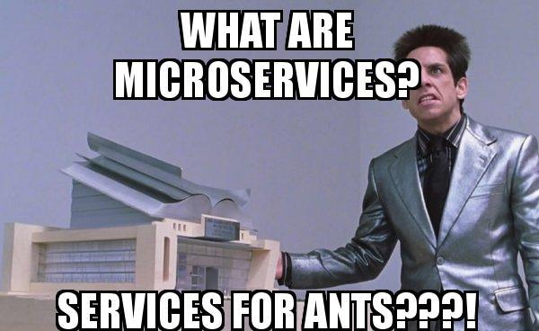
What Are Microservices?
Services or microservices?
How many (micro)services?

Slide 15

Services or Microservices?
YOU GET A SERVICE….
AND YOU GET A SERVICE….
AND YOU GET A SERVICE….
EVERYBODY GETS A SERVICE!!
Notes:
(Words come in every 3 seconds)
Initial design was straight services
This showed to become quickly a distributed ball of mud
Microservices was the natural evolution of the design

Slide 16
Are (Micro)services Perfect?
Testing/debugging complexity
Initial development effort
Communication
Notes:
Why haven’t we done this earlier if microservices are so great?

Slide 17
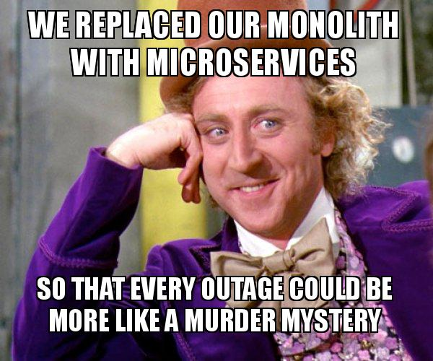
Microservices – Testing Complexity Increases
Notes:
Integration testing becomes much more complex, as there are now an order or magnitude or two more components to integrate
Similarly for debugging

Slide 18
Microservices – Initial Development Effort
Notes:
Theoretical chart to illustrate a point
First release of a new product has increased development cost
TBD if overall cost/time to first release increases

Slide 19
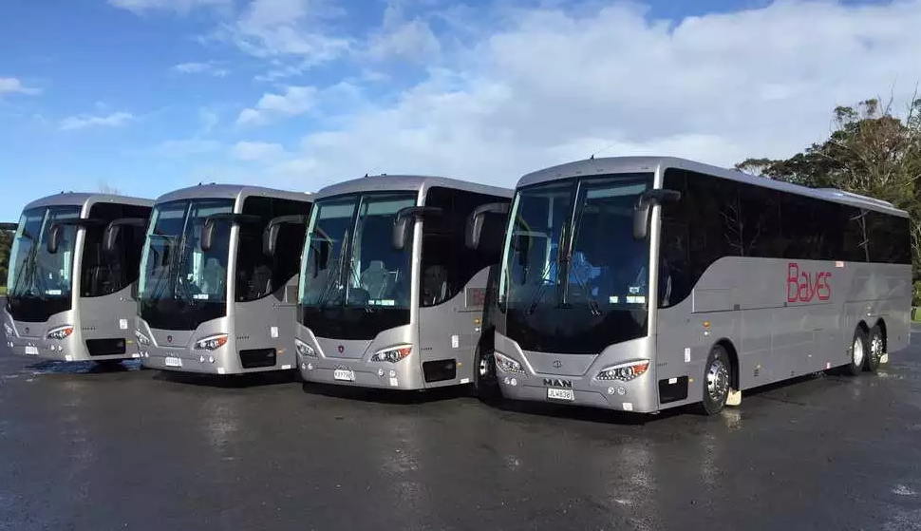
Microservices – Communication
Message Bus
Notes:
Message Bus has much more communication than simple monolith
Keep it minimized
Keep it fast

Slide 20
Mystique
Goals
How it works
Plans/timeline
Status

Slide 21
Mystique – Goals
Reduce bug escapes, bug introduction
Reduce cost
  New feature
  Maintenance & ports
Path to open architecture
Common software baseline
  Maximize reuse
  Fewer customer specific branches, consistent UX
Tolerant messages, fewer exits
Rapid payload integration
Thorough automated testing

Slide 22
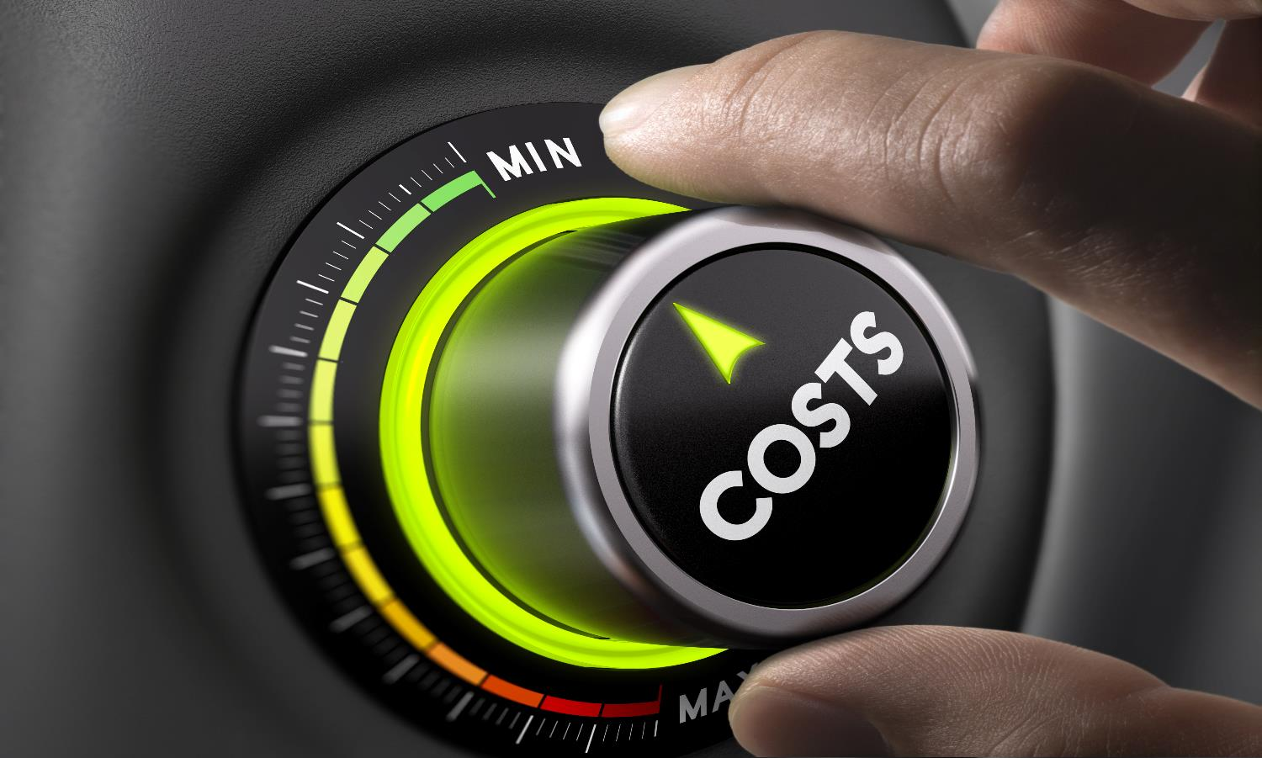
Goals – Reduce Costs
Maintenance
Initial Development
Additions
Reuse
Testing
Notes:
We expect to reduce the cost of
Bug fixes
New features
Testing
Reuse of existing components
We expect the cost to increase for
Initial development to Feature Complete

Slide 23
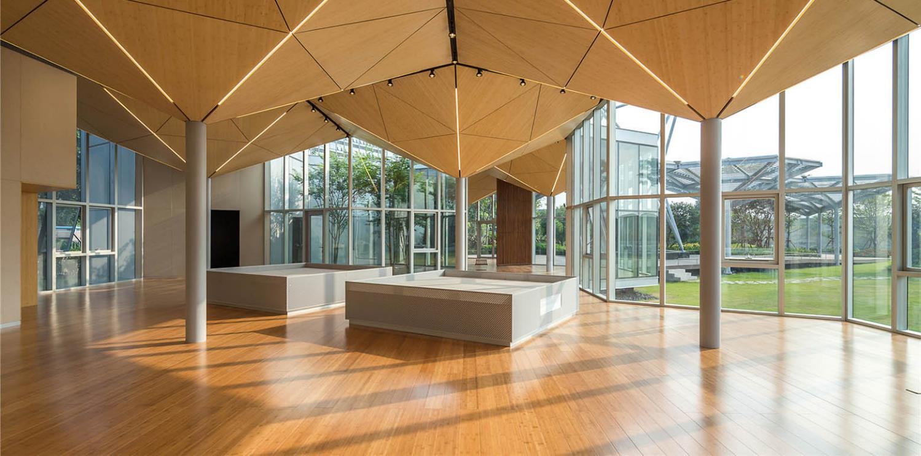

Goals – Path to Open Architecture
Notes:
Mystique itself is not (yet) an Open Architecture
Publish the interface to make that happen
Prepares for open architectures
OMS
FACE
etc
Not tied to one particular standard
Reconfigure (sub)components

Slide 24

Goals – Common Product Line
Project 2 UI
Project 3 UI
Project 4 UI
Common Services
(grows over time)
Project 1C UI
Project 1B UI
Project 1A UI
Notes:
Limit customer specifics to smallest surface area
UI in particular
Common service count grows over time

Slide 25

Goals – Not Common
Project 2 Branch(es)
Project 3 Branch
Project 4 Branch(es)
Common Components
(shrinks over time)
Project 1C Branch(es)
Project 1B Branch(es)
Project 1A Branch
Notes:
Today….
Whole application becomes customer specific
Common components become multiple customer specific ones over time
Sub branches of branches exacerbates the problem

Slide 26
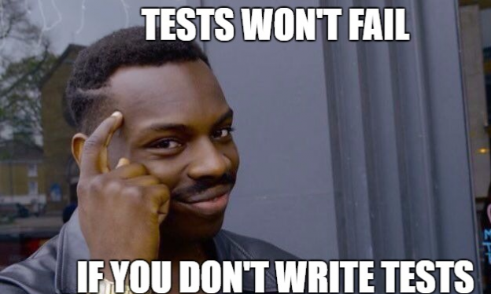
Mystique – Thorough Automated Testing
Notes:
Automated unit testing
Automated interface testing
Partly automated use case testing

Slide 27
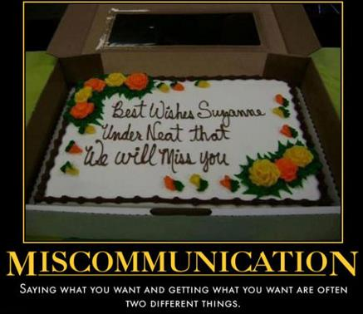
Mystique – From Here to There
SAYING WHAT YOU WANT AND GETTING WHAT YOU WANT
ARE OFTEN TWO DIFFERENT THINGS.
Notes:
We know what we want to achieve
We must manage things to get what we want

Slide 28
Backup

Slide 29
Mystique Redis Abstraction
Redis
B
O
U
N
D
A
R
Y
L
A
Y
E
R
3rd Party
Service 1
DDS
Other
Service 2
Message Technology
Service 3
3rd Party
Service 4

